Slide 1
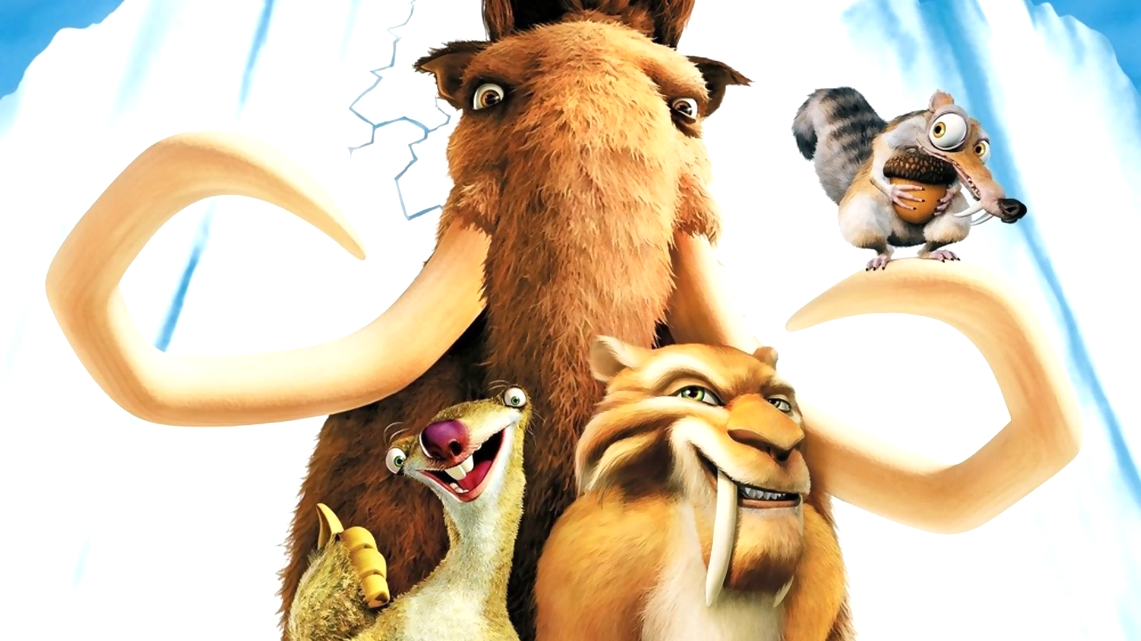
Some tasks for Ice Age
Alex Kireev

Slide 2
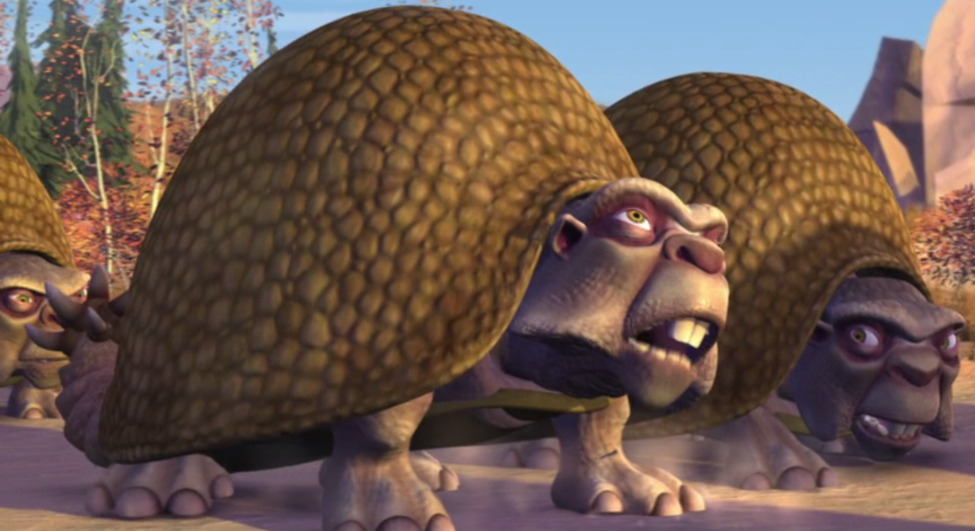
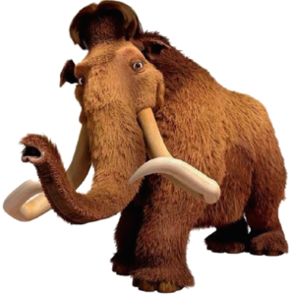
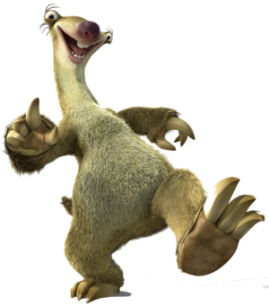
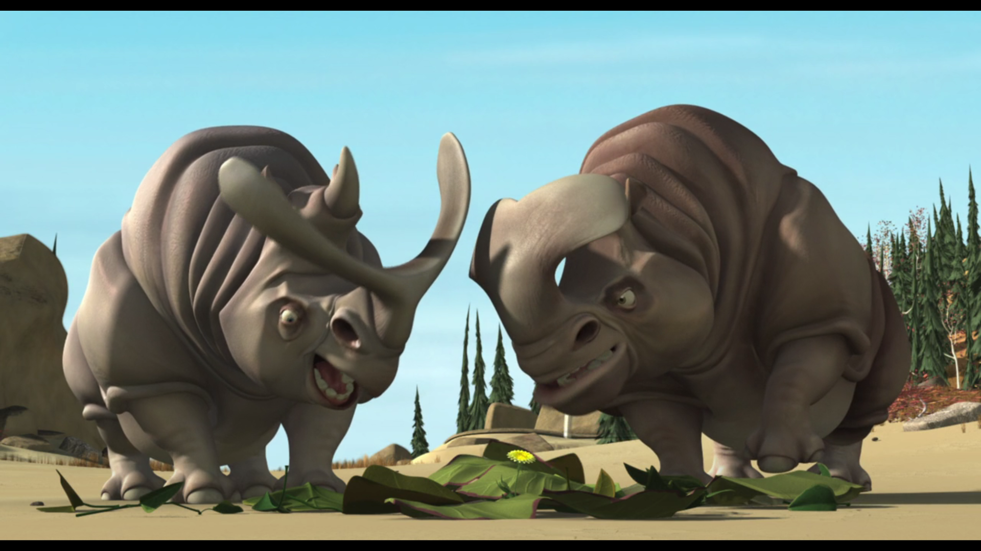
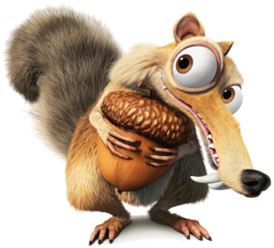
Name of these characters?

Slide 3
Name of these characters?
Carl
Sal
Frank
Sid
Manny or Manfred
Scrat

Slide 4
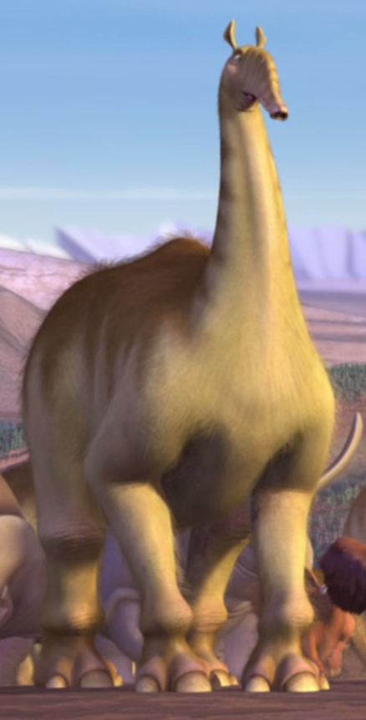
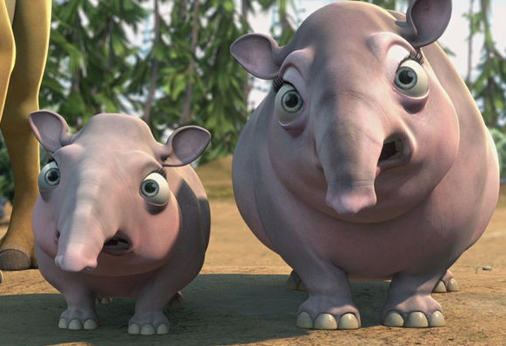
Before the next task
(Start)
(Glyptodont)
(Macrauchenia)

Slide 5
Who said it?
It's just a fact. No offence. You probably didn't even know what I'm talkin' about
Yeah. Yeah, that was a bluff.
A dandelion
Don't let them impale me. I wanna live
I thought the frost wiped 'em all out
Give me a break. We've been waddlin' all day
Things got a little chillier
Go ahead. Follow the crowd

Slide 6
Answers
It's just a fact. No offence. You probably didn't even know what I'm talkin' about (Sid)
Yeah. Yeah, that was a bluff (Manny)
A dandelion (Carl)
Don't let them impale me. I wanna live (Sid)
I thought the frost wiped 'em all out (Carl)
Give me a break. We've been waddlin' all day (one of starts)
Things got a little chillier (one of macrauchenia)
Go ahead. Follow the crowd (Manny)

Slide 7
Who said it?
Pine cones. Oh, my goodness. They're my favourite.
Just pretend that I'm not here.
I don't like animals that kill for pleasure.
I'm the mammal that cares
OK, if either of you make it across that sinkhole in front of ya, you get the sloth
No buts. You can play extinction later

Slide 8
Answers
Pine cones. Oh, my goodness. They're my favourite (Sid)
Just pretend that I'm not here (Sid)
I don't like animals that kill for pleasure (Manny)
I'm the mammal that cares (Sid)
OK, if either of you make it across that sinkhole in front of ya, you get the sloth (Manny)
No buts. You can play extinction later (one of starts)

Slide 9
Who said it?
I'm up. I'm up
Rise and shine, everybody
That has definitely not been my day. You know what I'm sayin', buddy.
He said he was on the verge of an evolutionary breakthrough
If my trunk was that small. I wouldn't draw attention to myself, pal
Do the world a favour. Move your issues off the road

Slide 10
Answers
I'm up. I'm up (Sid)
Rise and shine, everybody (Sid)
That has definitely not been my day. You know what I'm sayin', buddy (Sid)
He said he was on the verge of an evolutionary breakthrough (Sal)
If my trunk was that small. I wouldn't draw attention to myself, pal (Manny)
Do the world a favour. Move your issues off the road (one of starts)

Slide 11
Now, translate it))
Это известный факт. Так что без обид. Ведь нельзя обижаться на правду
Да, это был блеф
Одуванчик
Не дай им убить меня. Я хочу жить
Я думал мороз всё уничтожил
Извини, мы целый день в пути
Да, стало прохладнее
Ладно, топайте за остальными

Slide 12
Now, translate it))
Шишка. Чудесная шишка. Я их обожаю
Спрячь меня
Я не люблю тех кто убивает ради забавы
А меня это волнует (mammal - млекопитающее)
Хорошо. Переберётесь через воронку которая лежит перед вами, ленивец ваш
Никаких но. Потом поиграете в вымирание

Slide 13
Now, translate it))
Я не сплю. Не сплю
Эй, просыпайтесь!
Какой же сегодня неудачный день. Ты понимаешь о чём я?
Он что-то сказал об эволюционном прорыве
С таким коротеньким хоботком, я бы вёл себя поскромнее, парень
Сделай одолжение. Иди другой стороной

Slide 14
How it translated in Russian dubbing
It's just a fact. No offence. You probably didn't even know what I'm talkin' about
Это известный факт. Так что без обид. Ведь нельзя обижаться на правду
Yeah. Yeah, that was a bluff
Да, блефовал
A dandelion.
Одуванчик
Don't let them impale me. I wanna live
Не дай им убить меня. Я хочу жить

Slide 15
How it translated in Russian dubbing
I thought the frost wiped 'em all out
Я думал мороз всё уничтожил
Give me a break. We've been waddlin' all day
Извини, мы целый день в пути
Things got a little chillier
Да, стало прохладнее
Go ahead. Follow the crowd
Ладно, топайте за остальными

Slide 16
How it translated in Russian dubbing
Pine cones. Oh, my goodness. They're my favourite
Шишка. Чудесная шишка. Я их обожаю
Just pretend that I'm not here
Спрячь меня
I don't like animals that kill for pleasure
Я не люблю тех кто убивает ради забавы

Slide 17
How it translated in Russian dubbing
I'm the mammal that cares
А меня это волнует (mammal - млекопитающее)
OK, if either of you make it across that sinkhole in front of ya, you get the sloth
Хорошо. Переберётесь через воронку которая лежит перед вами, ленивец ваш
No buts. You can play extinction later
Никаких но. Потом поиграете в вымирание

Slide 18
How it translated in Russian dubbing
I'm up. I'm up
Я не сплю. Не сплю
Rise and shine, everybody
Эй, просыпайтесь!
That has definitely not been my day. You know what I'm sayin', buddy
Какой же сегодня неудачный день. Ты понимаешь о чём я?

Slide 19
How it translated in Russian dubbing
He said he was on the verge of an evolutionary breakthrough
Он что-то сказал об эволюционном прорыве
If my trunk was that small. I wouldn't draw attention to myself, pal
С таким коротеньким хоботком, я бы вёл себя поскромнее, парень
Do the world a favour. Move your issues off the road
Сделай одолжение. Иди другой стороной

Slide 20
Questions to discuss
Do you like cartoons?
Do you like Ice Age?
Which part of Ice Age do you like the most?
What is your favorite cartoon and film?

